Slide 2
Lesson 1: Object Oriented Fundamentals (10hrs)
Introduction
Object Oriented Analysis and Design
Iterative development and unified process
Case Study
Understanding Requirements
Use Case modeling, Relating Use cases — include, extend and generalization
Overview of the Unified Modeling Language: UML Fundamentals and Notations

Slide 3
USE CASE Exam
Create a use case diagram for a Library Management System. The system should allow members to search for books, borrow books, and return books. Librarians should be able to add new books, remove old books, and manage member records.
Create a use case diagram for an Event Management System. The system should allow attendees to register for events, view event schedules, and provide feedback on sessions. Event organizers should be able to create new events, schedule sessions, and manage attendee lists. Vendors should have the ability to apply for booth space and manage their profiles.

Slide 4
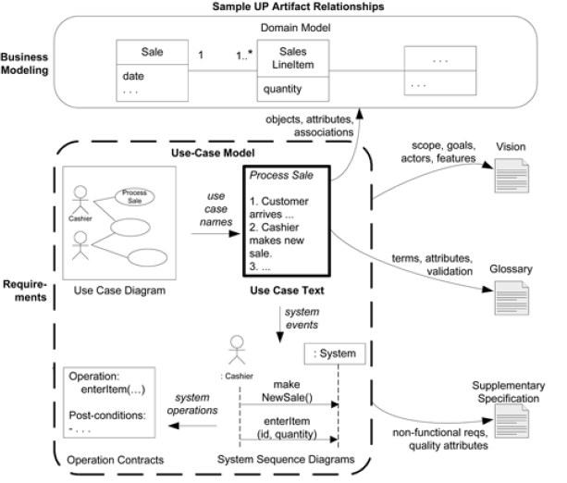

Slide 5
USE CASE Modeling
Use case modeling is a technique in software engineering to visually represent the interactions between actors (users or external systems) and the system under consideration.
It helps in understanding, documenting, and validating the functional requirements of a system from an end-user perspective.
Use cases are text stories, widely used to discover and record requirements.

Slide 6
Understanding Use Cases
Use Case Diagrams
Use Case Descriptions

Slide 7
Use Case Diagram
Use case is used to model the system or subsystem of an application.
Use cases represent specific interactions between external actors (users or systems) and the system to achieve a particular goal.
Use cases capture the functionalities the system provides to its users.
Each use case should represent a meaningful and cohesive piece of functionality.

Slide 8

Use Case Diagram
Actors
Definition: Actors are external entities (users or systems) that interact with the system by participating in one or more use cases.
Key Points:
Actors represent roles played by external entities.
Actors initiate and participate in use cases.
Represented by stick figures.

Slide 9
Use Case Diagram
Types of Actors
Primary: Lead actor, direct participation with the system
Secondary: Supporting actor, provides information to the primary actor
Off-Stage: Indirect participation provides support to both primary and secondary actors.
ATM System: - P: Customer S: Machine O: Bank

Slide 10
Use Case Diagram
Use Case:
Definition: Use case describes a set of actions or services the system provides to tits actors to accomplish a specific goal.
Key Points:
They are the features of the system.
Actors interact to achieve the objective of the use case.
Represented by the oval shapes.

Slide 11
Use Case Diagram
System Boundaries:
Definition: The system boundary separates the system from its external environment, defining what is inside and outside the system.
Key Points:
System boundaries help in defining the scope of the system.
External entities interact with the system at the boundary.
Represented by the box around the use cases.

Slide 12
Use Case Diagram
Association:
Definition: The line connecting an actor to a use case indicates that the actor performs that particular use case.
Key Points:
Represented by a line, line with an arrow, or dashed arrow.
<<extends>>
<<include>>

Slide 13
Use Case Diagram
Multiplicity:
Definition: Multiplicity defines the number of instances of one class related to one instance of the other class in an association.
Key Points:
Multiplicity indicates the number of actors or use cases associated with each other.
It is expressed using numeric ranges.
Represented by numbers like 0,1 or 0....* or 1....*.
1
0…1

Slide 14
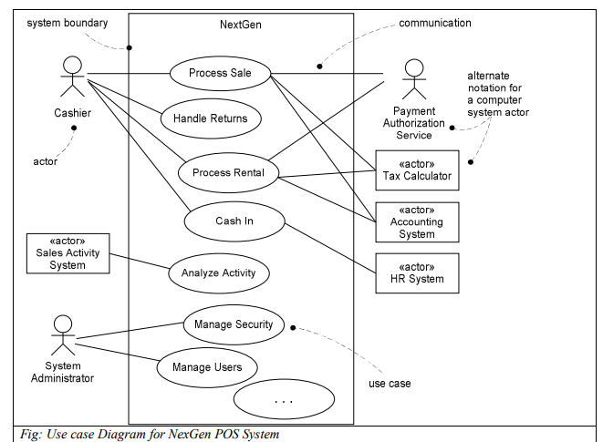
Use Case Diagram

Slide 15
Use Case Diagram
Prepare a Use Case Diagram of your project.
Guidelines:
Choose system boundary. (Identify internal vs external actors)
Identify primary actors
For each actor, identify user goals.
Define use cases that satisfies user goals.

Slide 16
Use Case Description
Components of a Use Case Description:
Use case descriptions provide detailed information about a specific use case, including its behavior and requirements.
Key Components:
Preconditions:
Conditions that must be true before the use case is executed.
Main Flow:
The primary sequence of actions that occur in a use case.

Slide 17
Use Case Description
Alternative Flows:
Variations or alternative paths that may be taken during the execution of the use case.
Postconditions:
Conditions that must be true after the use case is executed successfully.

Slide 18
Use Case Description
Key Points:
Use case descriptions are essential for documenting the expected behavior of the system.
Preconditions set the context for the use case.
The main flow outlines the standard or expected course of actions.
Alternative flows cover deviations or variations in the main flow.
Postconditions define the expected state or outcome after the use case is completed.

Slide 19
Use Case Description
For an "Online Purchase" use case:
Preconditions: Customer is logged in and has items in the shopping cart.
Main Flow: Customer selects items, adds them to the cart, proceeds to checkout, provides shipping details, makes payment, and completes the purchase.
Alternative Flow: If the payment fails, the system prompts the customer to retry.
Postconditions: Items are removed from the cart, and the customer receives a confirmation email.

Slide 20
Use Case Description Formats
Brief (high Level): concise one-paragraph summary, usually of the main success scenario.
It briefly describes a process, usually in two or three sentences.
It is useful to create this type of use case during the initial requirements to understand the complexity and functionality of a system quickly.
They are very terse and vague on design decisions and essential in nature.
It is useful to start with high-level use cases to obtain some understanding of overall major processes quickly.

Slide 21
Use Case Description Formats
Casual: informal paragraph format.
It comprises multiple paragraphs that cover various scenarios.
Addresses main and alternate scenarios and provides backup plan.
They are real and concrete in nature,

Slide 22
Use Case Description Formats
Fully Dressed: the most elaborate.
All steps and variations are written in detail, and there are supporting sections, such as preconditions and success guarantees.
These detailed use cases are written after many use cases have been identified and written in a brief format.

Slide 23
Use Case Description
Use Case ID
Use Case Name (Start with a verb)
Scope (The system under design)
Level (“user-goal” or “subfunction”)
Primary Actor (Calls on the system to deliver its services)
Stakeholders and Interests(Who cares about this use case and what do they want)
Preconditions (What must be true on start, and worth telling the reader)
Success Guarantee(Postconditions) (What must be true on successful completion, and worth telling the reader)

Slide 24
Use Case Description
Main Success Scenario (or Basic Flow) (A typical, unconditional happy path scenario of success)
Extensions (or Alternative Flows) (Alternate scenarios of success or failure)
Special Requirements (Related non-functional requirements)
Technology and Data Variations List (Varying I/O methods and data formats)
Frequency of Occurrence (Influences investigation, testing, and timing of implementation)
Open Issues

Slide 25
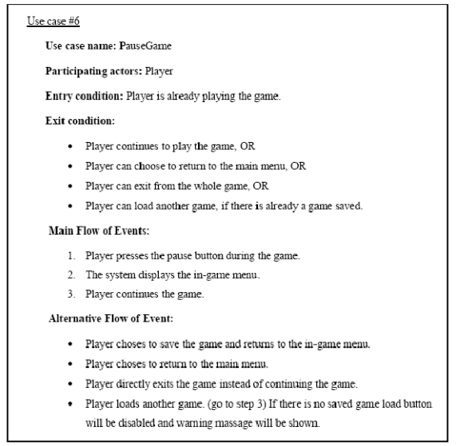
Use Case Description

Slide 26
Use Case Description
A use case describes three things:
An actor (user) that initiates an event
An event that triggers a use case
The use case that performs the actions triggered by the even

Slide 28
PREVIEW FOR LECTURE 5
USE CASE MODELING cont.

